Slide 1
RDG 101
A Crash Course
Notes:
This slide deck outlines a crash course on using Unreal Engine’s new Rendering Dependency Graph system (referred to as RDG).

Slide 2
Why the ‘RDG’ Acronym?
RHI = Rendering Hardware Interface
RDG = Rendering Dependency Graph
Intentional choice of acronym:
Symmetry with the RHI for naming resource: FRHITexture vs FRDGTexture;
Very close to the three syllables of Ren-Der-Graph;
More concise in code / email / chat.

Slide 3
Topics
0) Shader Parameters
1) Render Graph Basics
2) Pass Debugging and Methodology
3) Screen Pass Framework
4) Codebase Registry

Slide 4
Shader Parameters
Notes:
In order to understand the RDG architecture, it’s necessary to first understand how shader parameters are exposed in Unreal Engine. The shader parameter system is a foundational component to the design of RDG.

Slide 5
0.00: Shader Inputs in HLSL Source File
float2 ViewportSize;
float4 Hello;
float World;
float3 FooBarArray[16];
Texture2D BlueNoiseTexture;
SamplerState BlueNoiseSampler;
Texture2D SceneColorTexture;
SamplerState SceneColorSampler;
RWTexture2D<float4> SceneColorOutput;
Notes:
First, consider the following set of shader inputs declared globally in a hypothetical shader source file.

Slide 6
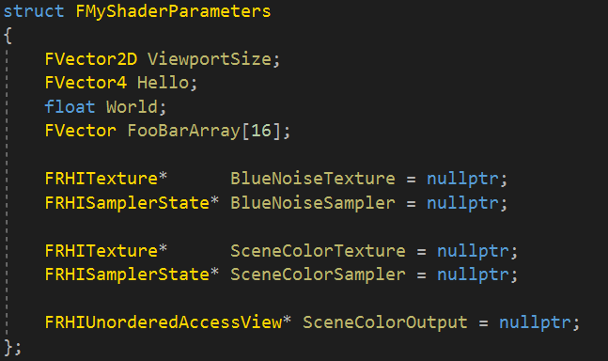
0.01: An Ideal C++ Equivalent
Notes:
Ideally, those shader inputs map to a C++ struct to be filled out by the user and submitted as a collection. Unfortunately, while easy to author, such a representation cannot be validated by the shader compiler runtime.

Slide 7
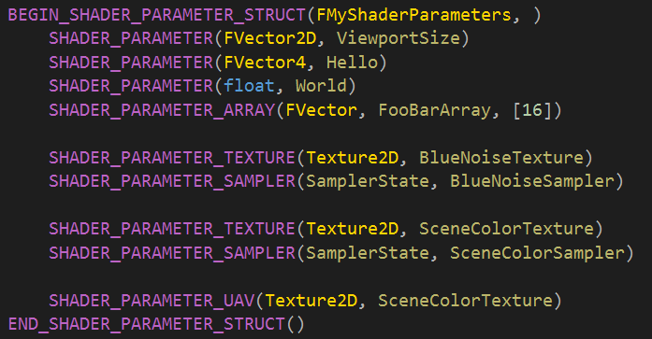
0.02: Shader Parameter Structs
Notes:
Unreal Engine uses a system of macros to define the shader parameter struct. This representation is relatively easy to author and automatically generates reflection information for the shader compiler.

Slide 8
0.03: Compile-Time Reflection Metadata
The SHADER_PARAMETER_STRUCT family of macros ultimately generate compile-time reflection metadata.
In C++, users can traverse and access information for each member:
Name;
Type;
Shader type;
Byte offset from start of struct.
This is necessary for extracting resources from a void* struct pointer in RDG / RHI.
See FShaderParametersMetadata::FMember for more information.
Notes:
A feature of the shader parameter macro system is that it will automatically generate compile-time reflection metadata. Any user can traverse the contents of a shader parameter struct at runtime and access per-member information. The metadata is necessary to traverse and extract resources from a void* pointer representation of the struct in common code (e.g. RHI / RDG).

Slide 9
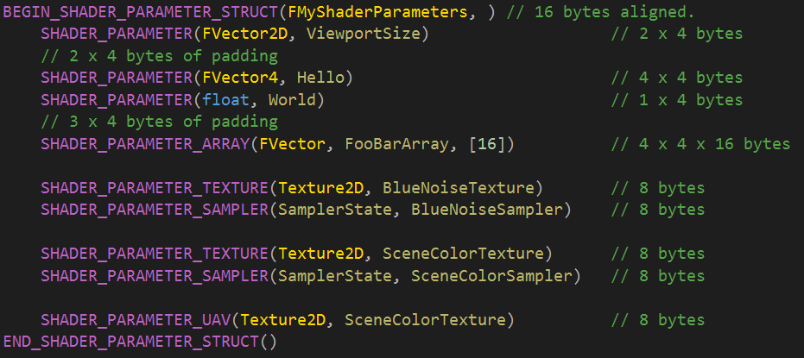
0.04: Automatic Parameter Alignment
Notes:
Another feature of the macro system is automatic alignment of shader data. Unreal Engine uses platform agnostic data alignment rules for shaders for portability.
The main rule is that each member is aligned to the next power of two of its size--but only if larger than four bytes. For example:
Pointers are eight byte aligned (even on 32 bit platforms);
Float, uint32, int32 are four byte aligned;
FVector2D, FIntPoint are eight bytes aligned;
FVector and FVector4 are sixteen bytes aligned.
The automatic alignment of each member will inevitably create padding as demonstrated in the comments above.

Slide 10
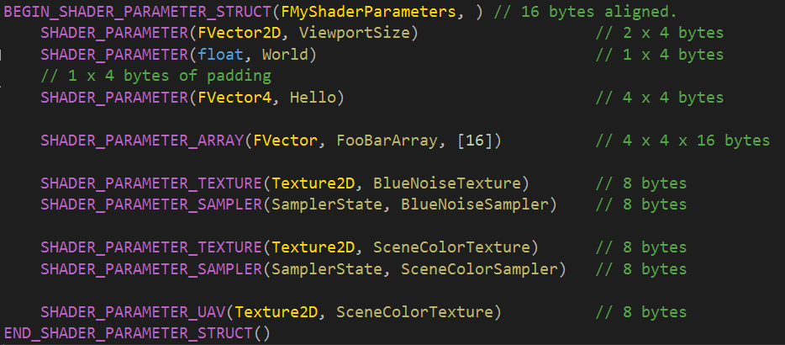
0.05: Sort Members to Minimize Padding
Notes:
As an aside, consider organizing the struct to minimize or eliminate padding. The order of parameters does not affect the shader source in any way, so this is a low-risk change that will result in fewer bytes being uploaded to the GPU. In the example above, moving up ‘float World’ allowed it to sit in the four byte padding region required for FVector2D ViewportSize (a three float structure). Again, this three-float vector will be aligned to sixteen bytes (or four floats), so moving the single-float member into the fourth float slot will eliminate the padding.

Slide 11
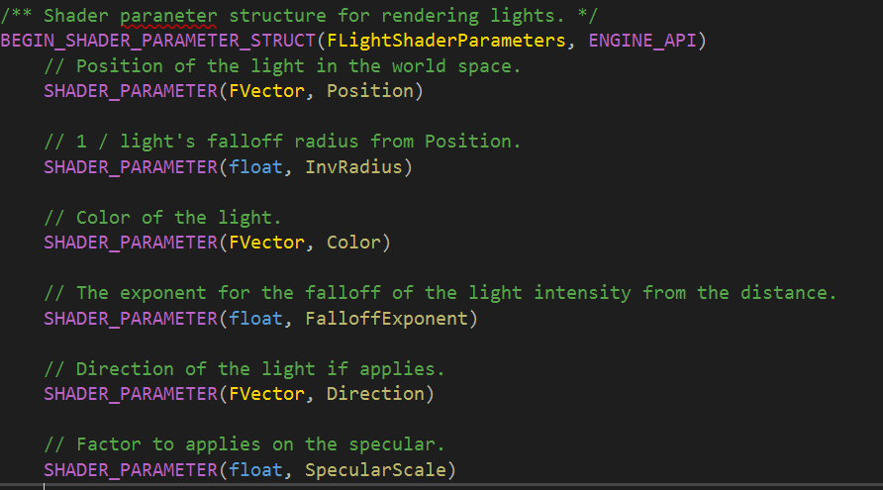
0.06: Example of Tightly Packed Structure
Notes:
The code snipped above demonstrates a tightly packed shader parameter struct. Each FVector {x, y, z} is followed by a float to complete the sixteen byte memory slot.

Slide 12
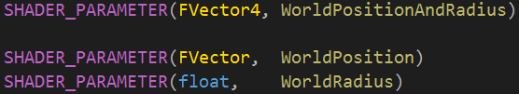
0.07: No Need to Manually Pack Floats
Notes:
Historically, shader authors have needed to manually pack loose floats into a larger 4-wide vector. This is not necessary when using the SHADER_PARAMETER_STRUCT system as long as the padding rules are followed. Keeping this data loose improves readability by avoiding generic parameter vectors (e.g. MyFeatureParams.{x, y, z, w}). This is also true for the shader source file, which can simply declare loose parameters with friendly names.
An exception is parameter arrays. The system will not explicitly merge parameters into a single array; you still have to do that yourself.

Slide 13
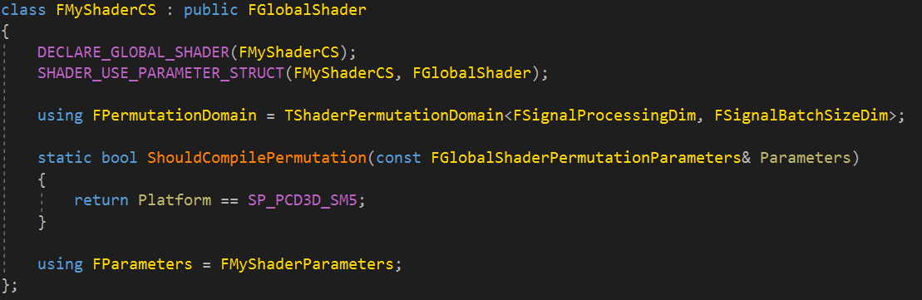
0.08: First Shader Class
Notes:
Now that we have a shader parameter structure for our shader, we need to define the shader itself. Using the new shader parameter system with the existing shader framework is trivial.
First, add the SHADER_USE_PARAMETER_STRUCT() macro to your shader class. This implements the constructor of the class and configures the shader to use the declared shader parameter struct. Raytracing shaders need to use SHADER_USE_ROOT_PARAMETER_STRUCT() instead, as there is some slight differences in how they are handled by the RHI. This requirement is temporary and will be removed in future revisions of the shader system.
Once configured, the shader will look for an FParameters member on the class. This should be assigned to the type of shader parameter struct you intend to use. Naturally, only one shader parameter struct is allowed per shader. Stay tuned for later slides which demonstrate how to effectively organize your shader parameter structs.
These two steps are all you need to begin using the shader parameter struct system. The class will reflect and bind shader parameters automatically. Note that the shader compiler will also validate bindings against this struct. For example, a type in C++ will now produce a helpful error message instead of failing silently.

Slide 14
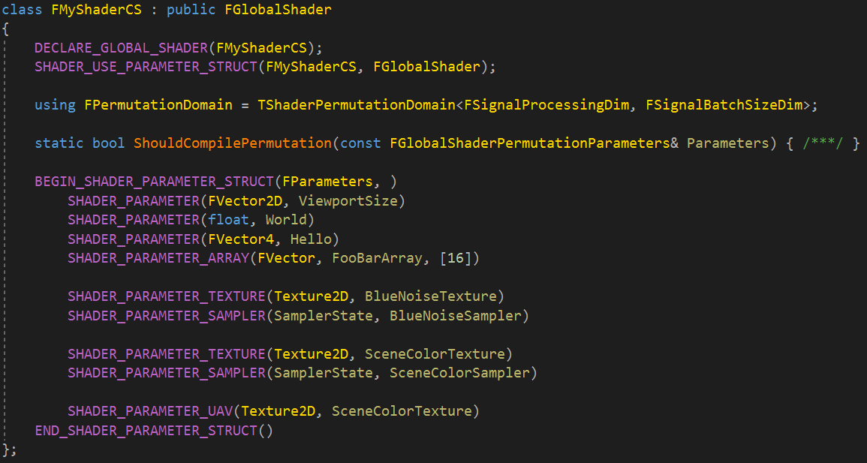
0.09: Inlining the Struct Definition
Notes:
A best practice for shaders with a 1-to-1 relationship to the parameter struct is to declare the parameters (as FParameters) directly on the class. This is the simplest and clearest approach.

Slide 15
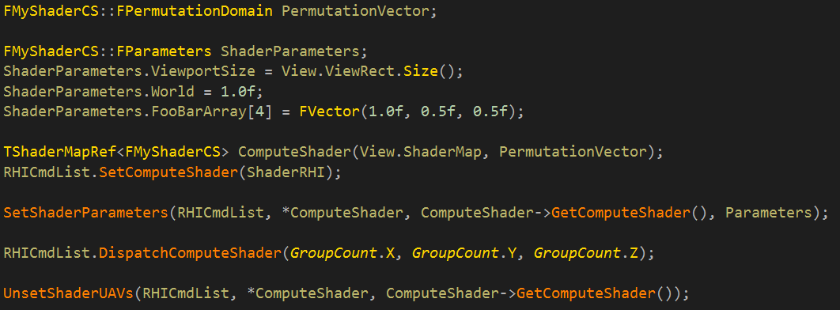
0.10: Assigning Parameters
Notes:
Our shader is now configured with a shader parameter struct. We now need to assign values to these parameters and push them to the RHI.
First, the FParameters type is just a struct; you can instantiate and fill it. This makes debugging trivial as you can now view the entire contents of the struct in the debugger.
A key differentiator of the new design is that shader parameter setup is decoupled from the shader class. This improves clarity by moving parameter setup into the higher-level pass code, rather than embedding it with boilerplate inside the shader class. This produces a more natural flow of data that is easier to read and debug.

Slide 16
0.11: Submitting Parameters
Notes:
The shader parameter system provides a helper function, SetShaderParameters, to push parameters to the RHI command list. This provides a clear location at which to inspect shader parameter values in the debugger.
This function will validate the contents the struct against the specific shader permutation being used. An error is emitted if a required resource is left null. As a side-note, all members of the struct are default-initialized to null, zero, or the default constructor (depending on the type).
This also means that a resource can be safely ignored if the permutation doesn’t use it.

Slide 17
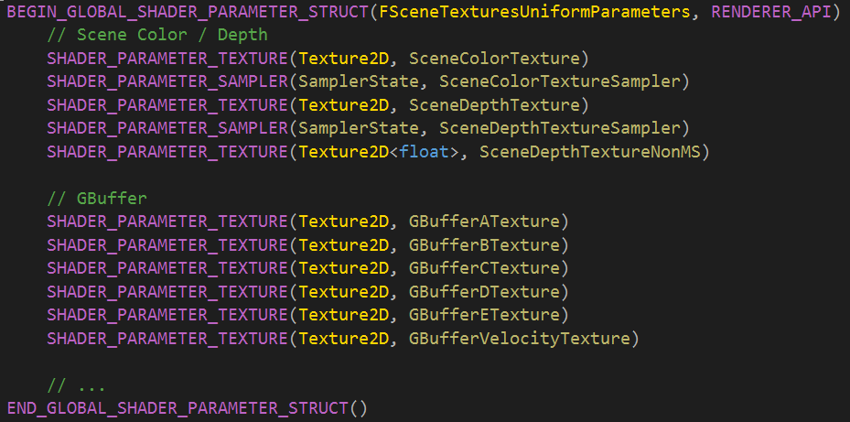
0.12: Defining a Uniform Buffer
Notes:
Uniform buffers utilize the same shader parameter struct model, but have their own dedicated macro for declaring the parameters as ‘Global’.

Slide 18
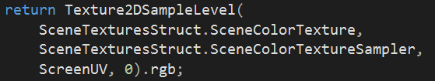
0.13: Uniform Buffer Code Generation
Common.ush already include the generated shader code
Then can access as a global structure (stored in uniform buffer)
Long term, shouldn’t have a syntax difference in HLSL between shader parameters and uniform buffer.
Notes:
A global shader parameter structure has the additional functionality (and overhead) of being automatically reflected in shader code, along with handling of some HLSL syntax particularities.

Slide 19
0.13: Uniform Buffer Code Generation
Common.ush already include the generated shader code
Then can access as a global structure (stored in uniform buffer)
Long term, shouldn’t have a syntax difference in HLSL between shader parameters and uniform buffer.

Slide 20
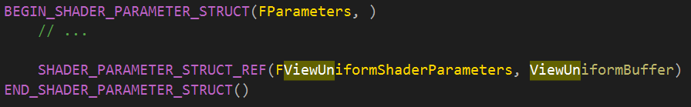
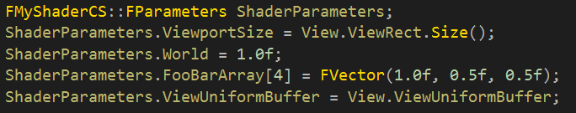
0.14: Include Uniform Buffers in Shader Parameter Structs
The view uniform buffer is ref counted in the structure:
TUniformBufferRef<FViewUniformShaderParameters>
Notes:
A shader parameter structure can reference uniform buffers through the SHADER_PARAMETER_STRUCT_REF() variant. Since this the shader binding name is defined by IMPLEMENT_GLOBAL_SHADER_PARAMETER_STRUCT(), the member name of the referenced uniform buffer is only used by C++.
Finally, because there is only one globally defined binding name, you can only have one instance of the uniform buffer bound at a time.

Slide 21
1: Render Graph Basics
Notes:
Armed with an understanding of the shader parameter system in Unreal Engine, we can now introduce the basics of RDG.

Slide 22
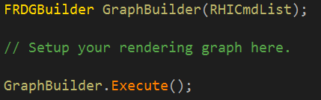
1.00: The Render Graph Builder
Notes:
The render graph API begins with the builder. This builder interface facilitates setup of the graph through immediate-mode declaration of resources and passes. The graph is built incrementally through the setup phase. Once all setup is complete, the graph is executed, which will compile and invoke all passes in dependency sorted order. Among other things, this design enables efficient scheduling of GPU work and more aggressive memory management.
The API is easy to use. You simply define a graph builder instance, perform setup operations, and execute. The builder is single-threaded (always on the render thread!) and no state is preserved between executions. The entire graph is rebuilt each frame.
In order to truly have whole-frame optimization, the ultimate goal is to port the entire engine to use the same graph builder instance. This will take a while. The preferred pattern for ‘porting’ existing code or writing new rendering code is to define your own local graph builder instance and execute it manually. As sections of the engine are ported, they will all be merged into the same builder instance.

Slide 23
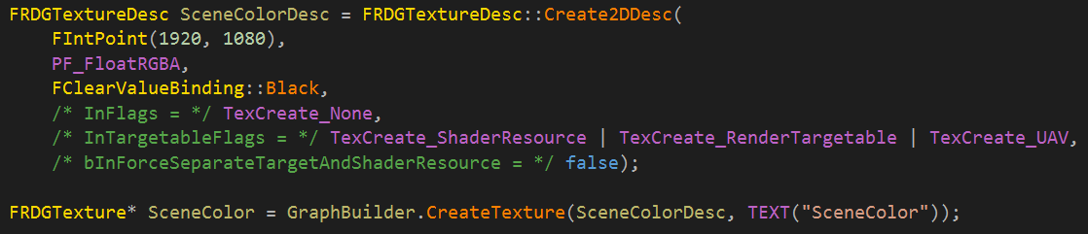
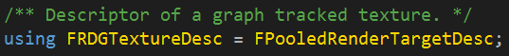
1.01: Creating a Texture
Notes:
To create a new texture, you simply call CreateTexture on the graph builder. This returns an RDG texture handle that is valid for the lifetime of the graph builder instance. The separate type is necessary because the physical GPU resource is not allocated immediately. The RDG pointer represents a handle to a future resource that is guaranteed to be valid for each pass that uses it. The details of how resources are associated to passes is covered shortly. All we have done in the code above is declare the texture on the graph.

Slide 24
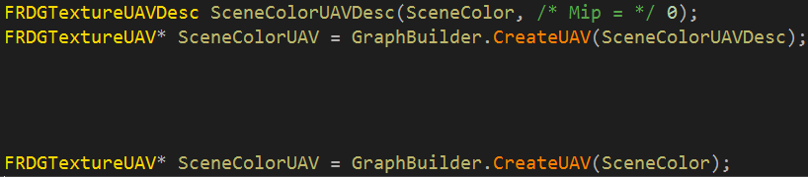
1.02: Creating a UAV for a Texture
Notes:
Similarly, you can use the builder to create views of a resource (texture or buffer). The code example above creates a UAV of the texture at the specified mip level.

Slide 25
1.03: Creating an SRV for a Texture
Notes:
SRV’s are also supported and follow the same general creation pattern.

Slide 26
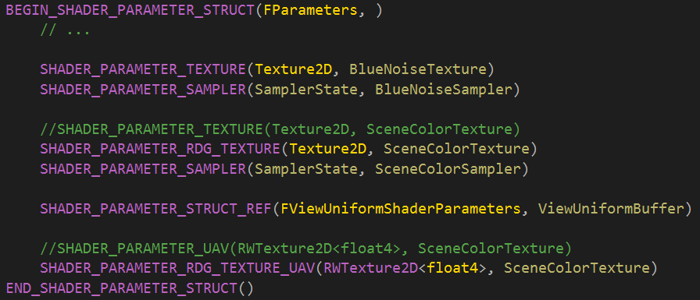
1.04: Pass Parameters
Notes:
In order to associate RDG resources with a pass (i.e. to be produced or consumed), we use a modified SHADER_PARAMETER_STRUCT declared with _RDG_ shader parameters. This variant of shader parameter accepts the C++ RDG resource pointer. The graph traverses this struct on the pass and registers RDG resources for the associated usage for the pass. This is where the memory management benefits come into play, as the graph is able to deduce the lifetime of resources based purely on how they are used by passes.
Looking at the code above, one may ask why we represent pass parameters using a shader parameter struct rather than some other ‘pass’ parameter struct. This was a conscious design decision to ease the authoring of passes which are 1-to-1 with a shader (this is the most frequent type of pass in the engine). The shader parameter struct above serves two purposes:
Pass Setup: since nearly all resources are produced / consumed through shaders, we can just pull from the shader metadata to know how the resource is going to be used in a pass (e.g. read vs. write). This information is crucial for resource transitions.
Setting Parameter Values to Command List: The shader within the pass doesn’t need to ‘extract’ the pass resource; it can simply bind the entire struct. The RDG resources are dereference automatically by the RHI shader parameter binding code.
By combining the pass / resource association into the shader parameter struct, it becomes trivial to write single-shader passes. Boilerplate is massively reduced, improving maintainability of the whole codebase.
To summarize: the shader parameter struct provides extensions to work with RDG resources. An RDG pass is provided this shader parameter struct, which it traverses and extracts all the information it needs to setup pass resources.

Slide 27
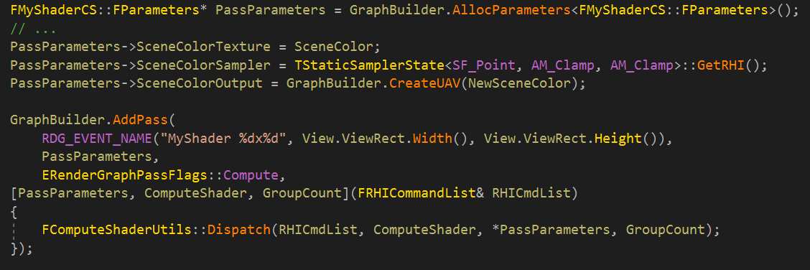
1.05: Adding a Pass
Notes:
To add a pass to the graph, the builder provides the AddPass function. This function accepts a lambda which is invoked during graph execution. The lambda provides an RHI command list to dispatch work to the RHI. The pass accepts a shader parameter struct, and will reflect all _RDG_ parameters from it. All other shader parameters are ignored.

Slide 28
1.06: Profile Events
Notes:
Each RDG pass accepts a formatted name which is exposed to the ProfileGPU command as well as external GPU profilers. You are encouraged to fill out enough information to uniquely identify the pass. Note that this information is dropped from release builds for performance reasons.

Slide 29
1.07: Pass Parameter Setup
1) Alloc parameters;
2) Setup parameters;
3) Associate to pass.
Notes:
As described previously, the graph needs to know which RDG resource a pass will access, which it gleans from a pass parameter struct. However, since the graph execution is deferred, this struct needs to be allocated to match the lifetime of the graph. The graph builder interface provides a AllocParameters function which is optimized for the lifetime of the graph. We prefer to use the PassParameters naming convention for this object.
Some rules regarding pass parameter structs and passes:
A pass parameters instance is considered immutable once associated to a pass via AddPass. The pass assumes ownership of the pointer (including destruction). Only a single pass my use a pass parameter instance (they must be 1-to-1). To support multiple passes, you must instantiate a unique instance for each.
It is not valid to allocate a pass parameter instance and then not associate it to a pass.
You may only access the underlying RHI resource of an RDG type in the pass lambda, and only if the RDG type was declared on the pass parameters instance associated with the pass.
The RDG validation layer will emit an error if these conditions are violated.

Slide 30
1.08: Pass Execution Lambda Function
Notes:
During execution, the graph will invoke the provided pass execution lambda function. This is where all RHI submission logic for the pass goes. Any RDG resource that was declared in the pass parameters is considered fully allocated and usable during this function (i.e. it is safe to access the underlying RHI type).
As a side note for lambda capture rules: the UE4 C++ standard prohibits the use of [=]; also, since the lambda execution is deferred, [&] is impossible. Instead, you will need to explicitly capture members individually.

Slide 31
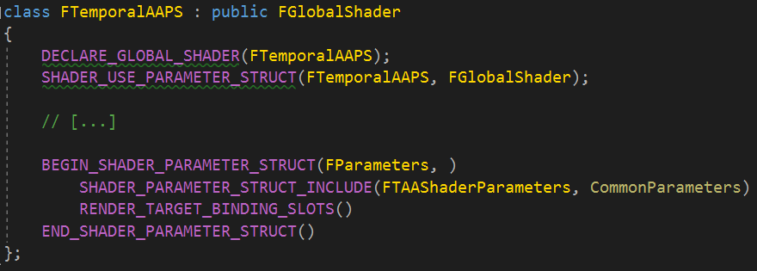
1.09: Render Target Bindings Slots
Notes:
When authoring a pass which uses the raster pipeline, add the RENDER_TARGET_BINDING_SLOTS() macro to your pass parameter struct. This exposes inputs for render targets and depth stencil which will be picked up by the pass. This data is ignored by shaders.

Slide 32
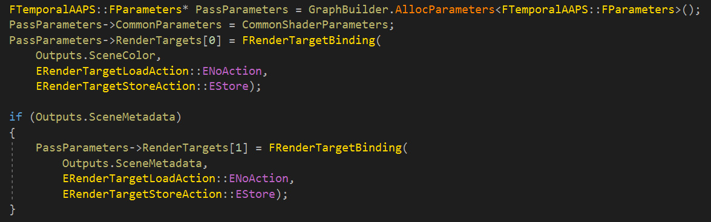
1.10: Binding a Color Render Target
Notes:
Render targets are exposed as an array of bindings. Each binding accepts an RDG texture along with the load / store action.

Slide 33
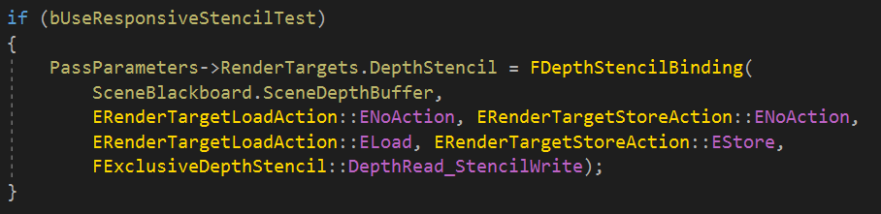
1.11: Binding Depth Stencil Target
Notes:
Similarly, depth stencil is exposed as a separate binding. It also accepts an RDG texture as well as load / store actions for depth and stencil separately. Furthermore, you can specify whether the texture is read or read-write.

Slide 34
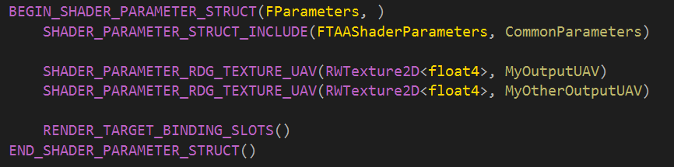
1.12: Binding UAVs for Pixel Shaders
Notes:
It is also possible to bind UAVs for pixel shaders.

Slide 35
1.13: Registration
Check out GRenderTargetPool.CreateUntrackedElement() to get a TRefCountPtr<IPooledRenderTarget> if need to register a different from RHI resource (for instance the very old FRenderTarget)
Notes:
Render graph currently utilizes the IPooledRenderTarget interface to control allocation of textures. It’s sometimes necessary to import an existing resource into the graph (especially during the RDG conversion process). The builder exposes RegisterExternalTexture, which returns an RDG texture instance backed by the existing render target.

Slide 36
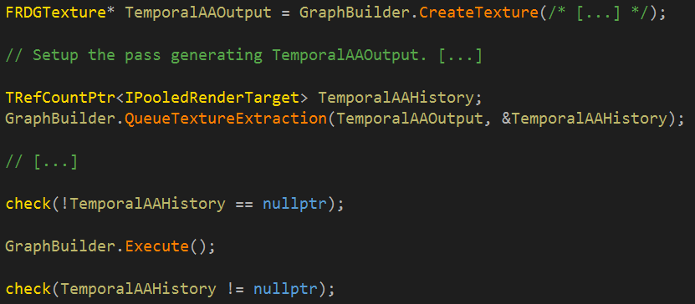
1.14: Extraction Queries
Notes:
The pooled render target pointer can also be extracted from a FRDGTexture. This allows you to preserve contents of a resource across graph invocations.
However, the extraction is deferred until the graph has executed; this is because the resource may be allocated during execution based on the lifetime of the resource in the graph.
The API therefore exposes QueueTextureExtraction, which allows you to provide a pointer which will be filled upon execution of the graph.

Slide 37
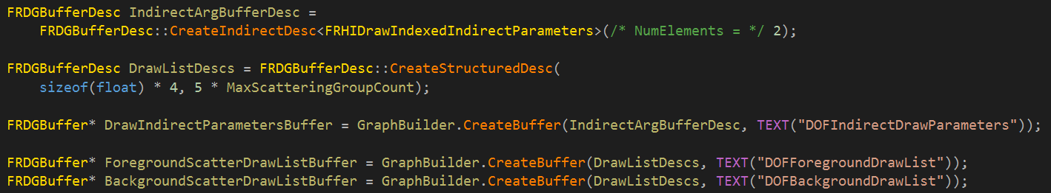
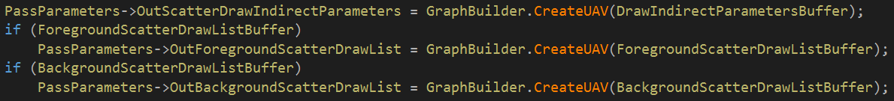
1.15: Creating Buffers
Notes:
The API naturally exposes methods to create buffers and views for them.

Slide 38
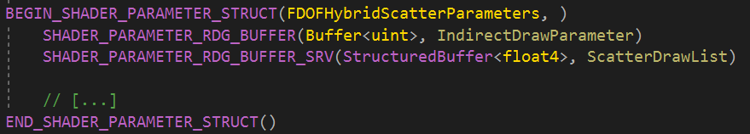
1.16: Reading from a Buffer Using an SRV
Notes:
The buffer can only be read from a shader through a SRV using SHADER_PARAMETER_RDG_BUFFER_SRV().

Slide 39
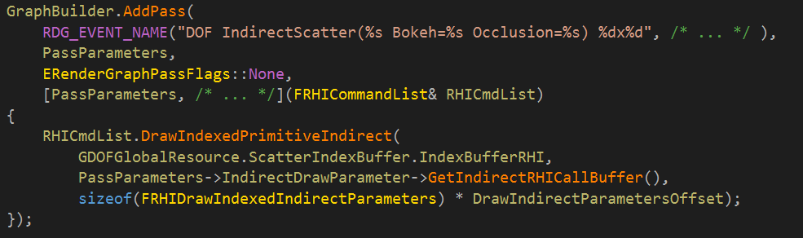
1.17: Indirect Draw/Dispatch Buffer
Notes:
Indirect draw / dispatch buffers are a bit unique in that they aren’t directly used by the shader. Instead, declare them as an RDG buffer on the pass parameters and then just use the RHI indirect draw buffer directly in the pass.

Slide 40
2: Pass Debugging and Methodology

Slide 41
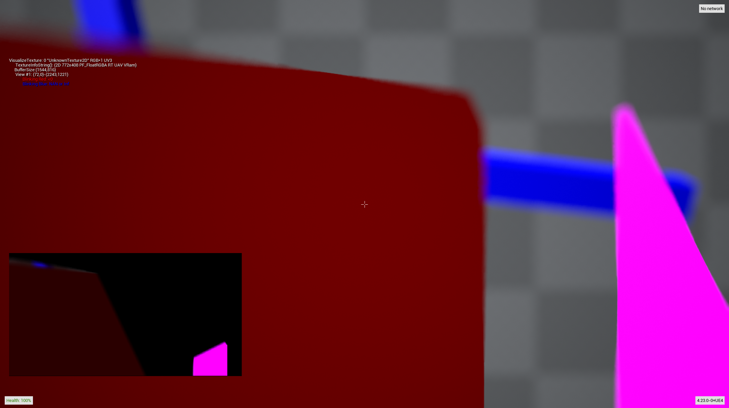
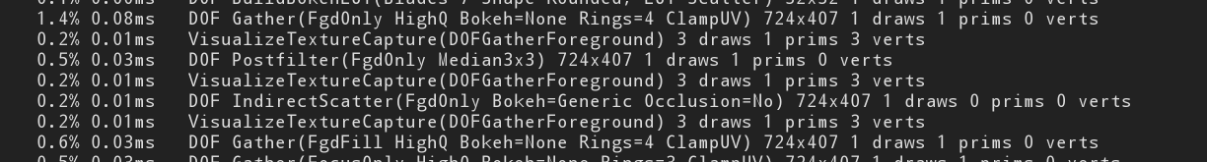
2.00: VisualizeTexture Integration
List all texture available
> vis
Look at a texture named “DOFGatherForeground”
> vis DOFGatherForeground
Notes:
RDG automatically exposes FRDGTexture to the visualize texture tool. Any write operation will be recorded. Just type the debug name you gave to the CreateTexture() directly in console and it will appear.
If you have multiple passes modifying or redefining a new texture with the same debug name, the capturing pass will capture all of them but only show you the last capture instance.

Slide 42
2.01: Selecting a Resource Version
Look at 2nd iteration specifically “DOFGatherForeground”
> vis DOFGatherForeground@1
Notes:
It is possible to select which version of the resource you want to visualize with the @N syntax.

Slide 43
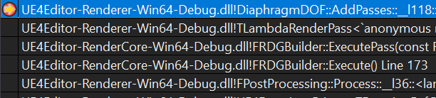
2.02: The Downside of Deferred Execution
Example of a breakpoint in DOF’s IndirectScatter pass (DiaphragmDOF.cpp)
Callstack in the lambda of the DOF’s IndirectScatter pass
Callstack of the implementation of RDG
Callstack in the post processing chain, not DOF. :(
The setup of the pass might hold the reason of your bug but it is long gone when executing the pass...
Notes:
A major downside of deferred execute is that it makes debugging difficult. If an issue occurs during pass execution, the source of the issue might be in the setup phase. However, since the setup stack frame is long gone, you lose all intermediate setup information. While it might be possible to set a breakpoint in the setup code, the issue might occur spuriously or the pass may be a common execution path (e.g. a downsample operation).

Slide 44
2.03: -rdgimmediate
Executes passes immediately as they get added;
Produces same functional behavior as deferred execution;
If break in execution, easy to inspect setup code;
Reason you can NOT modify PassParameter after AddPass()
Toggleable at runtime with r.RDG.ImmediateMode
Uses a lot of memory; consider running at lower resolution: r.Test.SecondaryUpscaleOverride
Notes:
To address this, RDG is capable of running in immediate mode. This will execute the pass immediately during AddPass. This mode uses a lot of memory, since references must be held on all allocations throughout the entire setup process (we don’t know whether resources will be used!). However, the debugging benefits are huge: you are able to set breakpoints during execution and see a clear call-stack of where things went wrong. This mode can be enabled at startup or at runtime.

Slide 45
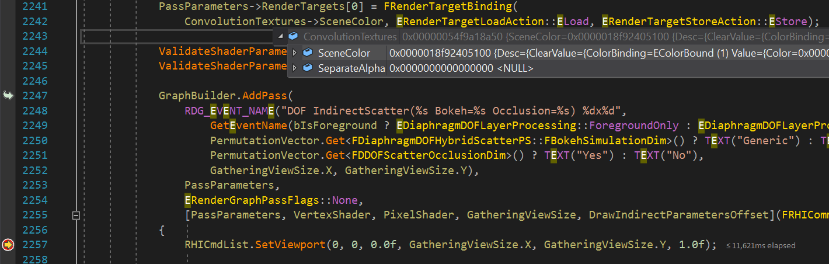
2.04: -rdgimmediate in action
Pass setup code
Pass execution code
Notes:
In this example, we hit a breakpoint in the Depth of Field IndirectScatter pass. With immediate mode enabled, we are able to browse contents of the ConvolutionTextures data structure which was prepared in the setup phase in order to investigate the issue.

Slide 46
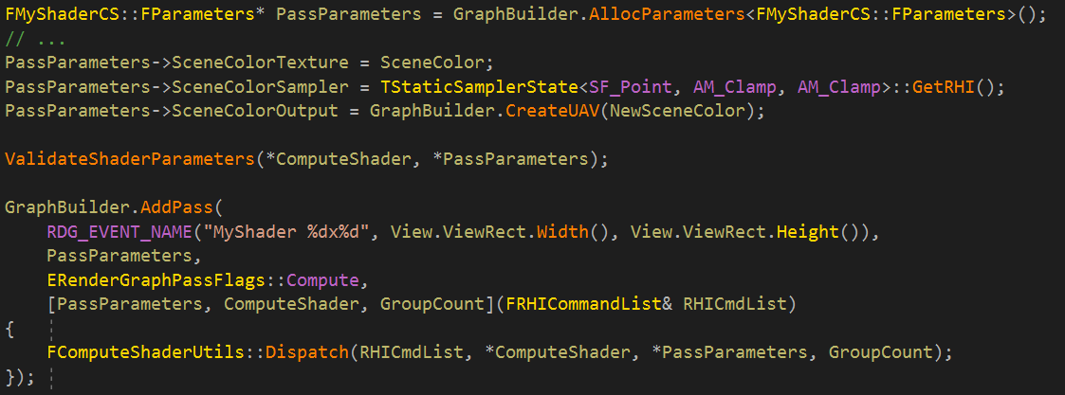
2.05: Early Validation of Shader Parameters
Notes:
A common mistake is to leave a required shader parameter empty. As mentioned earlier, the SetShaderParameters function will validate that all required shader parameters are present. However, it can be nice to catch these issues at setup time instead. Therefore, ValidateShaderParameters is provided to allow you to ensure that everything is present prior to adding to the pass.

Slide 47
2.06: -rdgdebug
Extra validation warning that are too CPU costly to check all the time;
Catch things like (but not limited to):
Unneeded resource for pass;
Resources produced by pass but not needed.
Toggleable at runtime with r.RDG.Debug=1.
Notes:
RDG provides a rich validation layer that can catch issues with graph setup as well as performance problems. More expensive validation is hidden behind a CVar which can be enabled through the command line or during runtime. One of the common cases for validation is to catch resources which are declared but not actually used by the pass.

Slide 48
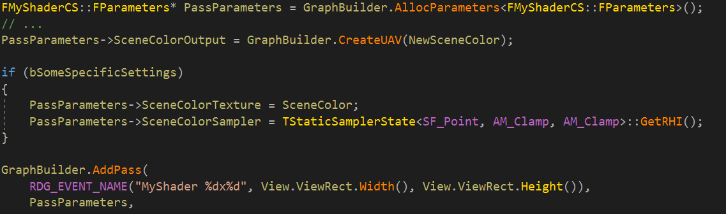
2.07: Dependency Methodology: White-Listing
Notes:
AddPass will process all RDG resources found in the pass parameter struct--even if they are not actually used by the graph execution function! This includes operations like allocating memory and performing barriers / layout transitions which can be costly. To eliminate unnecessary cost, it is important to only provide resources actually used by the pass. Since shader parameters are default-initialized to null, the simplest solution is to white-list resources you need by branching assignment on the condition of their usage (example above).

Slide 49
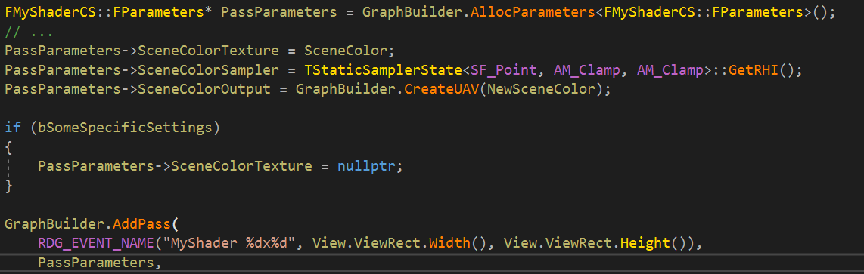
2.08: Dependency Methodology: Black-Listing
Notes:
Similarly, you could also use the same logic to null out resources that aren’t used when a certain condition is met.

Slide 50
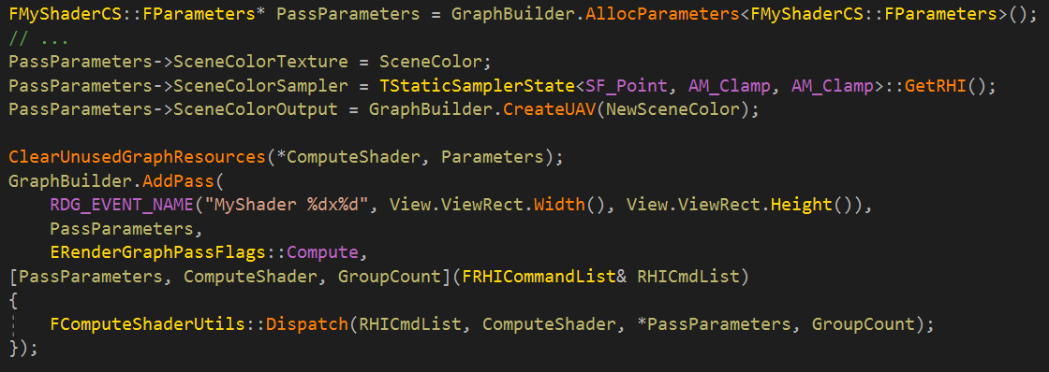
2.09: Automatic Black-Listing For a Single-Shader Pass
Automatically does ValidateShaderParameters() before modifying your pass parameters!
Notes:
A majority of the time, passes just wrap a single compute or pixel shader operation. As shaders contain a number of permutations, this creates a potential maintenance nightmare of having to hand tweak your pass parameters to black-list unused resources. Instead, RDG provides a utility function which will do this for you: ClearUnusedGraphResources. The function takes a single shader and nulls out all resources NOT used by the shader. This removes those resources from the pass entirely, which in turn elides the cost of tracking them through the graph.
The utility function will automatically call ValidateShaderParameters for you prior to nulling out any resources. This is avoid confusion by ensuring that all required resources are present before nulling out unused resources.

Slide 51
2.10: Repetitive AddPass Pattern
Hold on a minute… this is boiler plate!

Slide 52
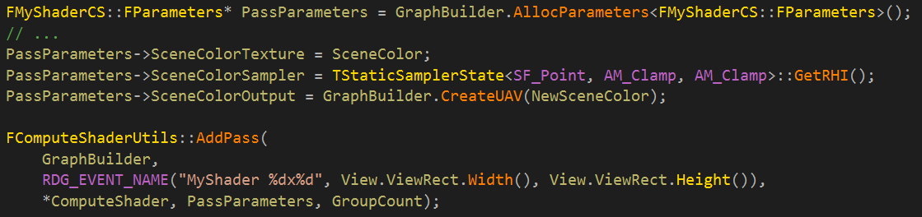
2.11: Use Helpers as Often as Possible
Less copy-pasted code; fewer bugs; easier maintenance!
Don’t hesitate making new ones as you identify new cases that come often in code.
Just make sure you aren’t duplicating them. Check out the helper section.
Notes:
For common cases, like compute shaders, utility functions can remove a lot of boilerplate. Less boilerplate means fewer copy-paste bugs and easier maintenance.

Slide 53
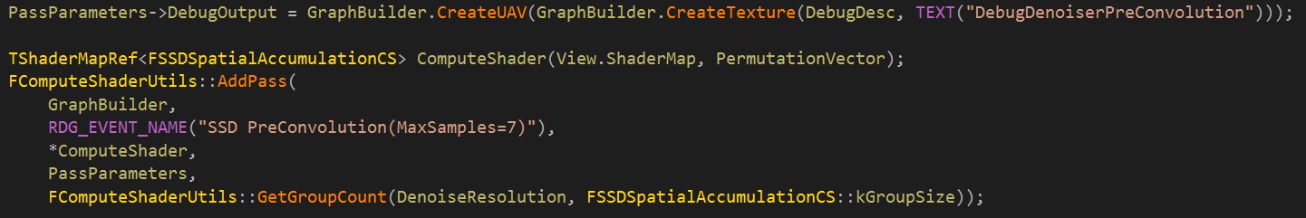
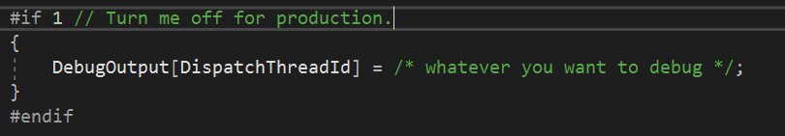
2.12: GPU Debugging UAV Trick
C++:
Shader:
UE4 console:
> vis DebugDenoiserPreConvolution UV0
ClearUnusedGraphResources() will remove dependency when disabled in shader code -> no cost for production code path!
Notes:
As an aside, here’s a neat trick: sometimes when debugging a shader, you just need good old-fashioned printf debugging in a texture. This can be setup once in C++ and conditionally enabled in shader code!
The basic idea is to create an optional RDG texture and associated UAV, then bind it to each pass you care to debug throughout development of the feature. Then, in the shader code, you can conditionally declare existence of the texture resource and write whatever you want to it. The system will automatically cull out the resource when it is not active. You can use the visualize texture tool to see the contents of your custom texture!

Slide 54
2.13: Need More than 4 Channels in a Texture?
May need to encode information more than what a pixel format may offer. (Obvious example: GBuffer)
-> Need to read from and write to more textures.
-> Need to setup all this textures as if they were just one.
-> Would like to abstract these details.
Notes:
As another methodology example, consider a pass which works from several texture channels--more than the maximum of four supported by any single texture. It would be nice to abstract some of this setup so that the implementation treats them as a single collection.

Slide 55
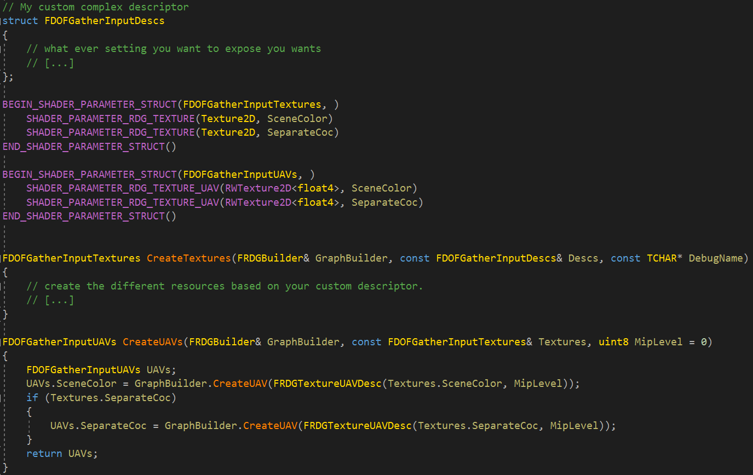
2.14: Use Structs to Group Resources
Notes:
To achieve this, we can group these resources into shader parameter structures and create methods to initialize them. The implementation of these functions can abstract the details of whether or not to include the additional texture references.

Slide 56
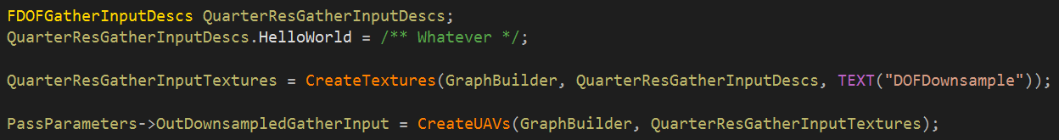
2.15: Resource Structure Setup
Notes:
The structure of textures behaves like a native RDG resource. Complexity in the setup code is abstracted into separate functions, resulting in more modular code.

Slide 57
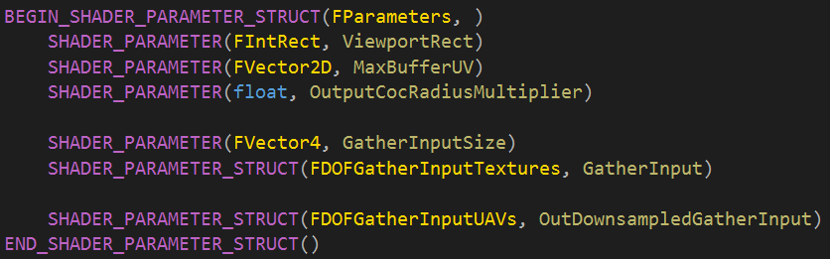
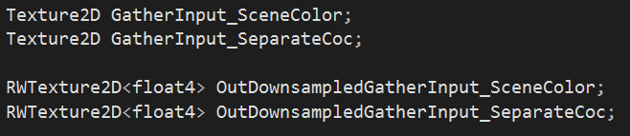
2.16: Flexible Structure Nesting
C++ code:
Shader code:
Notes:
Shader parameter structs can be nested. In C++, this is just composition of structs. In shader code, you have to prefix struct members with the name of the struct, separated by an underscore. In this example, instead of manually listing all the input textures, we can simply reference the structs.

Slide 58
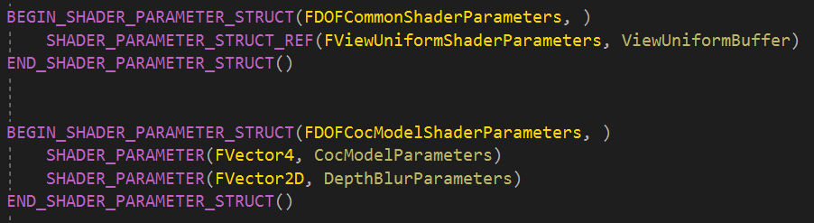
2.17: Nesting Common Parameters
Notes:
There is nothing specific about resources structures. Any shader parameter can be nested. A recommended pattern is to identify common shader parameters shared between multiple passes. These parameters can be extracted into their own struct, filled once, and then copied around. Having a single code path to setup the common parameters reduces maintenance costs.

Slide 59
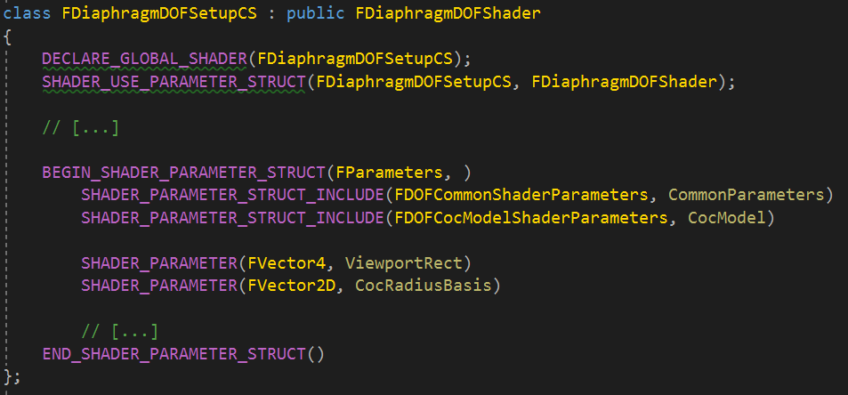
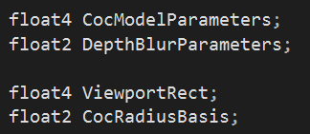
2.18: Include Shader Parameter Struct
C++ code:
Shader code:
Notes:
It’s also possible to nest a child structure on the C++ side, but absorb all shader names into the parent scope. In the example above, piecemeal parameter structs are built and then composed into the shader’s parameter struct. To avoid creating superfluous naming prefixes on the shader side, the SHADER_PARAMETER_STRUCT_INCLUDE variant is used. This results in shader names that are flattened into the global scope, removing the structure prefixes. This is really useful when organizing frequency of update in C++. For example, you may have a sequence of passes which reference the same common shader parameters. By including the common parameters, you can build them at the beginning of your pass setup and simply copy them around.

Slide 60
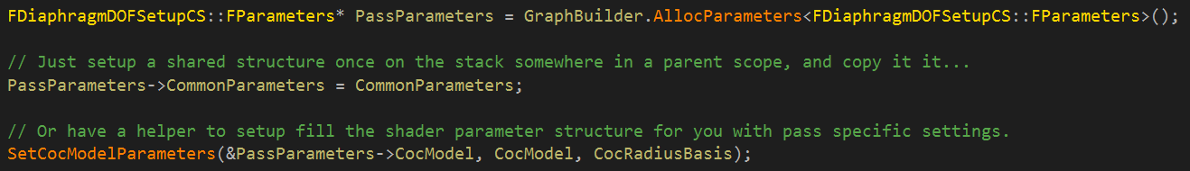
2.19: Setup Nested Structures as You Please
Notes:
The nesting system is flexible enough to support most needs. Use your judgement to organize parameters according to the needs of your feature (e.g. code duplication, verboseness, etc). Unreal Engine provides the tools you need to achieve this.

Slide 61
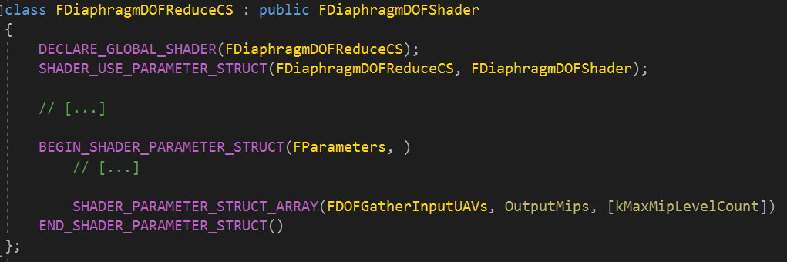
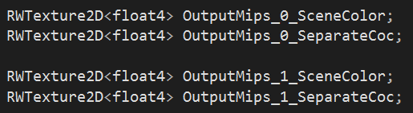
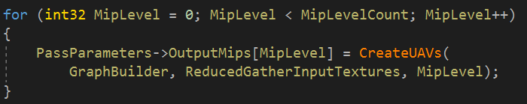
2.20: Structure Arrays
Shader class:
Shader code:
Shader parameter setup:
Notes:
We presented earlier the convenience of organizing resources into structures with FDOFGatherInputTextures. It turns out that one of the Depth of Field shaders needs to generate a mip chain for each texture of this resource structure. The system supports arrays of shader parameter structures on the C++ side to aid with this use case. The C++ becomes a lot more convenient to set up all the UAVs per layer with a intuitive for loop. The shader code isn’t greatest, because of same reason as structure nesting, but at least the C++ side doesn’t suffer from this restriction.

Slide 62

2.21: Event Scopes
Notes:
To better organise timings in the GPU debugging tools, event scopes can be added in code to contain all passes created within it.
Events are a lot more useful when combined with information performance-relevant information. Depth of Field, for instance, may have to support the alpha channel. This changes buffer layout and increases texture fetches. However, putting this information on each pass might result a lot of noise. This is information that can be stored on the entire scope instead.

Slide 63


2.22: GPU Timing Aggregation
Setup code:
UI:
Notes:
In addition to draw events, UE4 tracks GPU timing statistics in buckets. These are shown with the `stat gpu` console command.
GPU statistics support is integrated with RDG solely in scope form. The pass GPU timing will be aggregated with the innermost scope at pass setup.

Slide 64
3: Screen Pass Framework

Slide 65
3.00: What is a Screen Pass?
Just a pass that reads texture inputs and writes texture outputs;
The majority of passes in the engine;
Helps frame the problem space.
Primarily targets pixel shaders;
Components of the framework are applicable to compute as well.
Opted for Screen Pass naming convention instead of Post Process;
More generic;
E.g. SSS is part of lighting composition--not really a post process;
Notes:
First of all, what is a screen pass? Essentially, it’s just a pass that reads texture inputs and writes texture outputs. The definition applies to a majority of passes in the engine and helps frame the problem space. While the framework primarily targets pixel shader passes, certain components are applicable to compute passes as well. A note on naming: we opted for the “screen pass” convention instead of “post process”. We felt this was more generic. For example, subsurface scattering is not technically a post process, since it runs during the lighting composition phase.

Slide 66
3.01: Simplify Pass Authoring
Screen pass requirements;
Shader parameters to describe inputs / outputs;
Texture extent, viewport, etc.
Majority just need a pixel / compute shader;
Hidden area mesh? Full screen triangle?
Handling arbitrary viewport regions;
Split screen / VR.
Dynamic resolution scaling.
Screen pass framework provides solutions to these problems.
Notes:
Armed with the previous definition, let’s consider the basic set of requirements of a screen pass. Firstly, the shader will likely need information about its textures; for example, the extent in pixels or viewport region in UV coordinates. Next, a significant majority of the time, screen passes only need a single pixel or compute shader. An important consideration for pixel shaders is whether to render with an HMD hidden area mesh for VR, or simply a fullscreen triangle. Finally, as we’ll see more in-depth a bit later, we need the flexibility to render into a viewport of an output texture or sample from a viewport of an input texture. Use cases for this include split screen or VR and dynamic resolution scaling. Ultimately, the screen pass framework exists to solve these problems.

Slide 67

3.02: Texture Viewports
Simple class to group the viewport / extent pair.
Used to derive shader parameters;
Used to specify input / output viewports for screen passes;
Used to derive UV transforms between viewports.
Notes:
The screen pass framework explicitly defines a texture viewport. This data structure describes a rectangle oriented within a texture extent--both specified in pixels. We need both in order to express the viewports in UV coordinates and map between viewports. As we’ll see in subsequent slides, it’s used by the framework to derive shader parameters, define input and output viewports for screen passes, and derive UV transforms between viewports.

Slide 68
3.03: Understanding Texture Viewports
Texture viewport regions can differ from input to output.
E.g. resolving post process chain to split screen viewport (and vice versa).
Would like to abstract from shader code.
Mostly a setup detail. Shader doesn’t care.
Destination Viewport
Destination Texture
Source Viewport
Source Texture
Samples From
Notes:
To understand the need for texture viewports, consider a pass with a single input and output texture. An important realization is that these two viewports can differ. Split screen is an obvious example of this. We may need to read from a split screen viewport, process some intermediate chain of passes, and then composite the results back to the split screen viewport. Ideally, these details are abstracted from the shader code as much as possible.

Slide 69
3.04: Multiple Input Viewports
Texture viewports can differ between inputs;
E.g. anything after TAA upsample which also requires depth / velocity.
We need an easy way to map UV coordinates between viewports.
Velocity Tile
Velocity / Depth
Result
Samples From
Upsampled Scene Color
Notes:
In more advanced scenarios, texture viewports can even differ between inputs. In motion blur, for example, depth and velocity share a single viewport; however, scene color has been upsampled from TAA, so it has a second viewport; finally, the velocity tile classification texture has a third. In short, we need an easy way to map UV coordinates between these viewport spaces.

Slide 70

3.05: Texture Viewport Parameters
Describes a texture viewport to the shader;
Extent, Viewport, UV Viewport, etc;
Not tied one-to-one with a texture;
Can be shared (e.g. depth / velocity);
Define as many or few as you need.
Notes:
To solve the shader parameter problem, the framework defines a new shader parameter struct derived from a texture viewport. It provides such information as the extent and inverse extent of the texture; the viewport rectangle in pixel or UV coordinates, etc. By design, it is not coupled with a specific texture instance, as multiple inputs to a pass tend to share the same texture viewport. Instead, you can define as many as needed for your pass.

Slide 71


3.06: Texture Viewport Parameter Setup
Member of pass parameter struct.
Notes:
To use the texture viewport parameters, simply add it as a member of the pass parameter struct we’ve seen in earlier slides. You can instantiate parameters straight from a texture viewport instance.

Slide 72

3.07: Defining in the shader.
Use the SCREEN_PASS_TEXTURE_VIEWPORT macro in HLSL.
Defined in ScreenPass.ush.
Notes:
On the shader side, the framework provides a macro to define texture viewport parameters in HLSL. This removes the need to painstakingly add each individual member. It is defined in ScreenPass.ush.

Slide 73


3.08: Draw Screen Pass API
Used for pixel shader passes.
Abstracts HMD mesh vs fullscreen triangle;
Abstracts vertex shader setup.
Specify input / output texture viewport;
Automatic RHI viewport setup;
Automatic UV coordinate generation.
Other low-level variants exist:
E.g. manual submission to command list.
Notes:
To make working with pixel shaders easier, the framework includes utility functions to add pixel shader passes directly to the render graph. It abstracts details like whether to use an HMD mesh or fullscreen triangle. You supply the input and output texture viewports, and the implementation automatically handles RHI viewport setup and UV coordinate generation. Other low-level variants of this function exist if you need more control; for example, if you need to manually setup your pass and submit to the command list.

Slide 74


3.09: Transform UV’s Between Viewports
Simple scale / bias factor to map UV from one viewport to another;
Seen it used enough times to warrant making it a first class citizen.
Removes the need to keep deriving (or copy pasting) the transformation code.
Can use the SCREEN_PASS_TEXTURE_VIEWPORT_TRANSFORM macro.
Notes:
Finally, the framework provides a simple transform type to map UV coordinates from one viewport space to another. To instantiate, simply pass your source and destination viewport. In the shader code, apply the scale / bias factors to the source UV coordinate. In the shader, you can use the SCREEN_PASS_TEXTURE_VIEWPORT_TRANSFORM macro to quickly define the transform.

Slide 75
4: Codebase Examples

Slide 76
4.00: Pixel Shader Passes
Full-screen pixel shader
VisualizeTextureCapture
Screen pass pixel shader with HMD mesh support
SSS
Motion Blur
Stencil test
SSR Stencil Setup
TAA Pixel Shader

Slide 77
4.01: Indirect Draw / Dispatch
Indirect draw with VS and PS sharing same parameter structure
FDOFHybridScatterParameters
Indirect dispatch pass
FComputeShaderUtils

Slide 78
4.02: Shader structure convenience
Pixel shader & compute shader support for same pass (share some parameters)
FTAAShaderParameters
Resource structures
FSSDSignalTextures
FDOFGatherInputTextures
Setup one shader parameter structure, add multiple passes
FRayTracingReflectionsRGS::FParameters CommonParameters;
SHADER_PARAMETER_STRUCT_INCLUDE() in a uniform buffer
FDeferredLightUniformStruct

Slide 79
4.03: Various Engineering Approaches
Extensibility of the renderer by plugin
IScreenSpaceDenoise
Interface a UTextureRenderTarget2D as a IPooledRenderTarget
FPostProcessing::Process()

Slide 80
Some Additional Readings
UE4’s Rendering composition graph in 2012 by Martin Mittring (first presentation slide mostly used in post processing chain, it is what we deprecated to replace with RDG)
Frostbite’s FrameGraph in 2017 by Yuriy O’donnell
Halcyon’s RenderGraph in 2018 by Graham Wihlidal

Slide 81
Thank You for Using RDG

